Slide 1
Problems Solving by Searching
The searching algorithms are divided into two categories
1. Uninformed Search Algorithms (Blind Search)
2. Informed Search Algorithms (Heuristic Search)
There are six Uninformed Search Algorithms
1. Breadth First Search
2. Uniform-cost search
3. Depth-first search
4. Depth-limited search
5. Iterative deepening depth-first search
6. Bidirectional Search

Slide 2

Breadth First Search
Expands shallowest unexpanded node. It can be implemented by calling TREE- SEARCH with an empty fringe, ie., FIFO queue (i.e., new successors go at end)

Slide 3
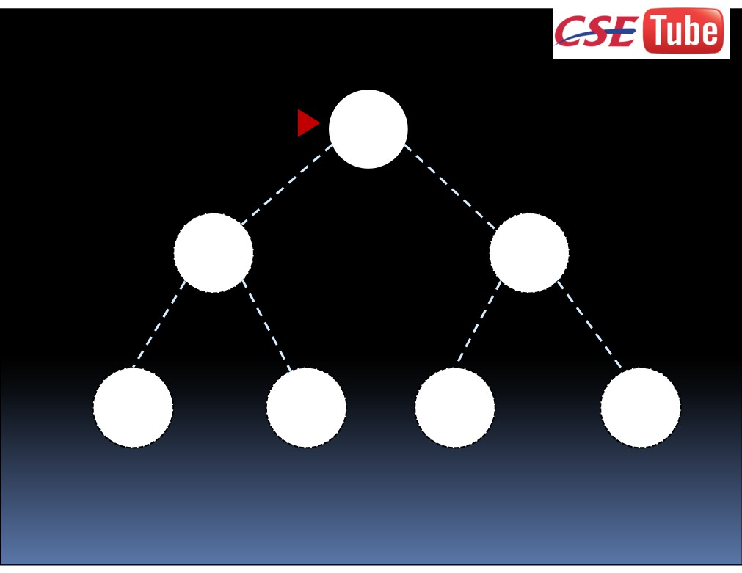
A
B
C
D
E
F
G

Slide 4
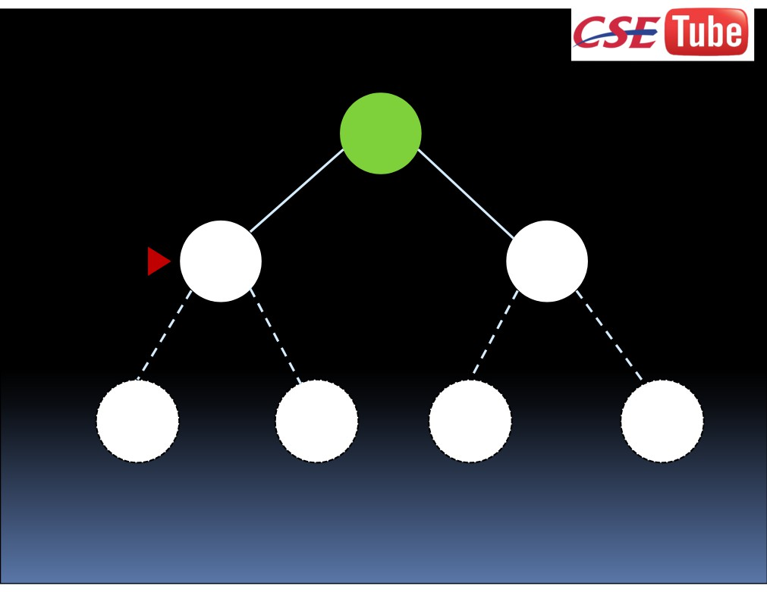
A
B
C
D
E
F
G

Slide 5
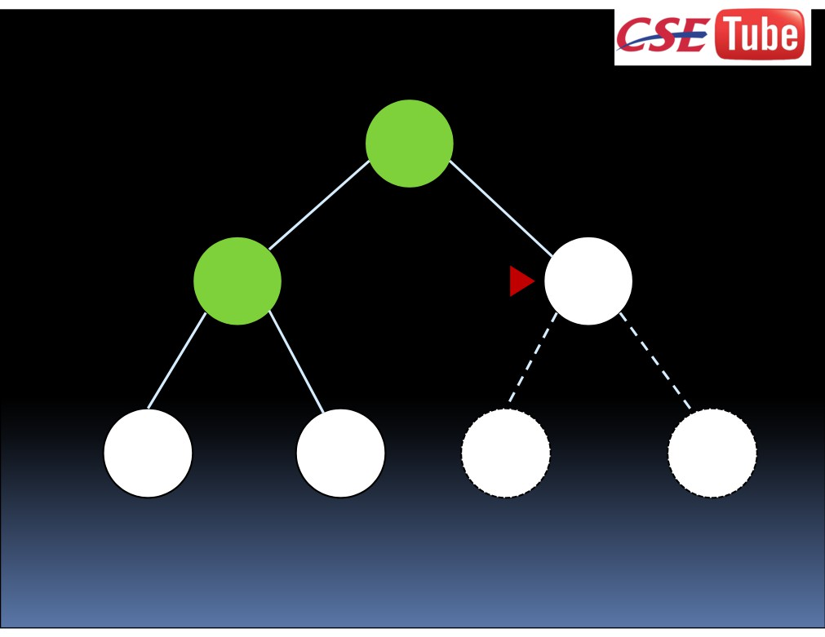
A
B
C
D
E
F
G

Slide 6
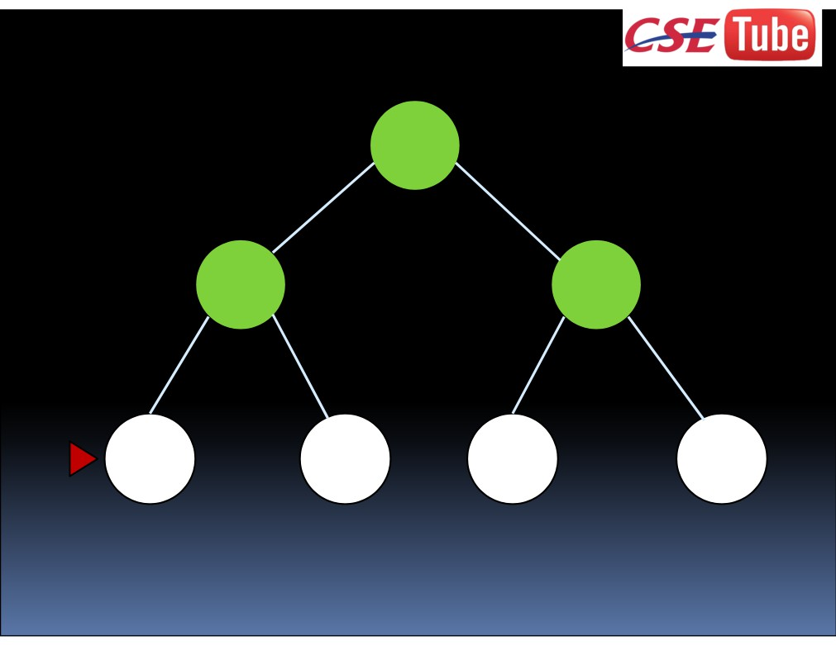
A
B
C
D
E
F
G

Slide 7
Properties of breadth first search: Completeness? Yes (if b is finite)
Optimality? Yes, unless step costs are constant Time complexity? 1+b+b2+b3+…+bd+b(bd-1) = O(bd+1)
Space complexity? O(bd+1) (keeps every node in memory)

Slide 8
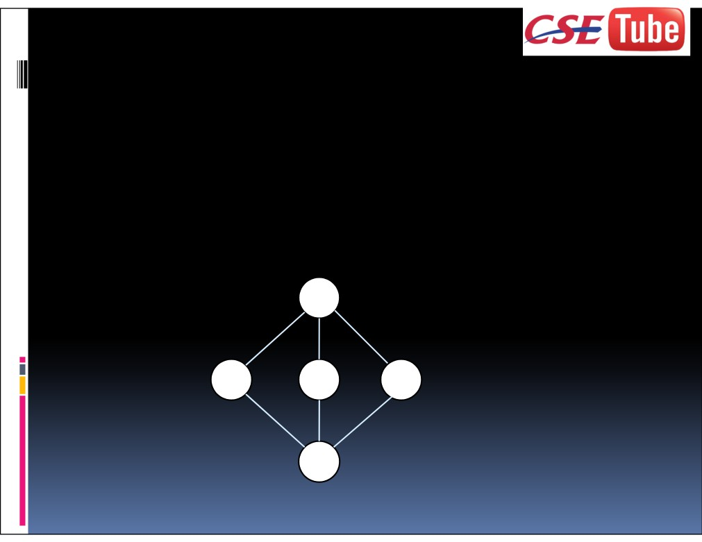
Uniform Cost Search
Expands least cost unexpanded node.
It is equivalent to breadth first search if all step costs are equal.
Implementation: fringe = queue ordered by path cost, lower first.
S
1
10
3
A
B
C
12
5
5
G

Slide 9
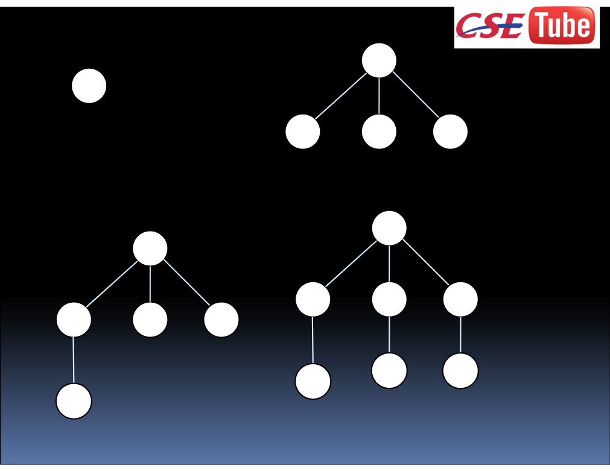
S
S
A
B C
1
3 10
S
S
A
B C
A B
C
3
10
G G
G
G
8 15
13
13

Slide 10
Properties of uniform cost search:
Completeness? Yes (if step cost ≥ `)
Optimality? Yes, unless step costs are constant Time complexity? 1+b+b2+b3+…+bd+b(bd-1) = O(bd+1)
Space complexity? O(bd+1) (keeps every node in memory)

Slide 11
Depth First Search
Expands the deepest node in the current fringe.
Implementation: fringe = LIFO queue, i.e., put successors at front.

Slide 12
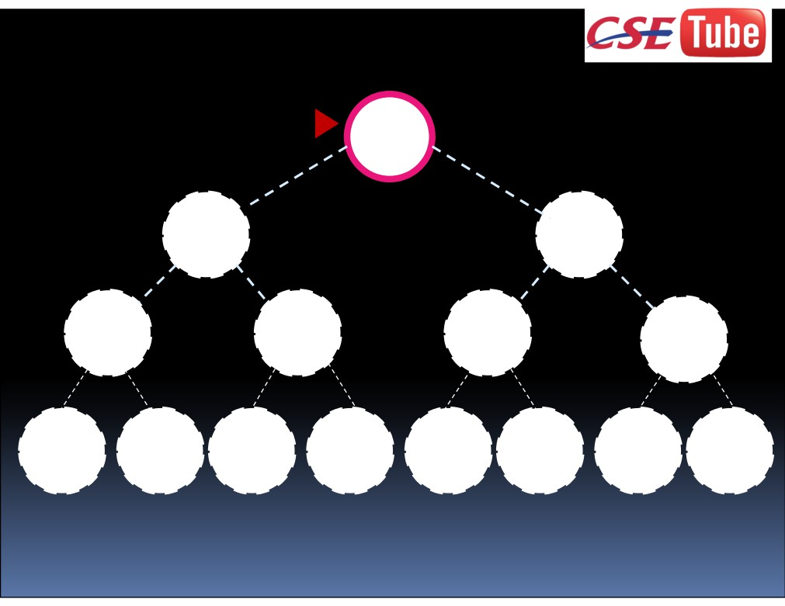
A
B
C
D
E F
G
H I J K L M N O

Slide 13
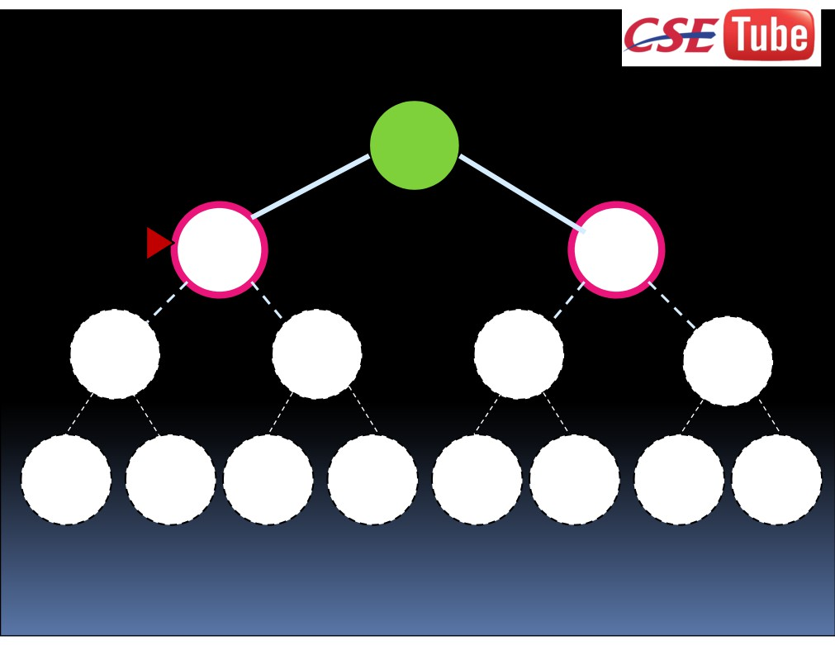
A
B
C
D
E F
G
H I J K L M N O

Slide 14
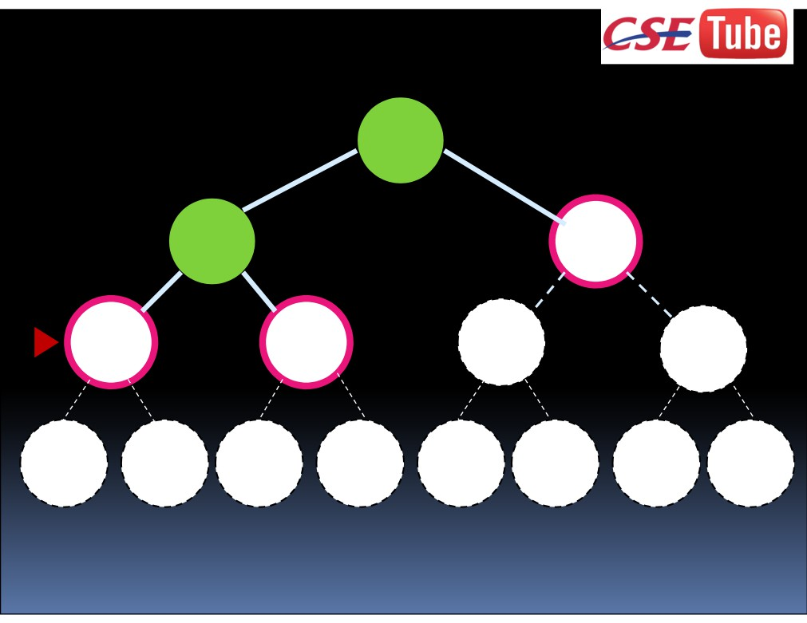
A
B
C
D
E F
G
H I J K L M N O

Slide 15
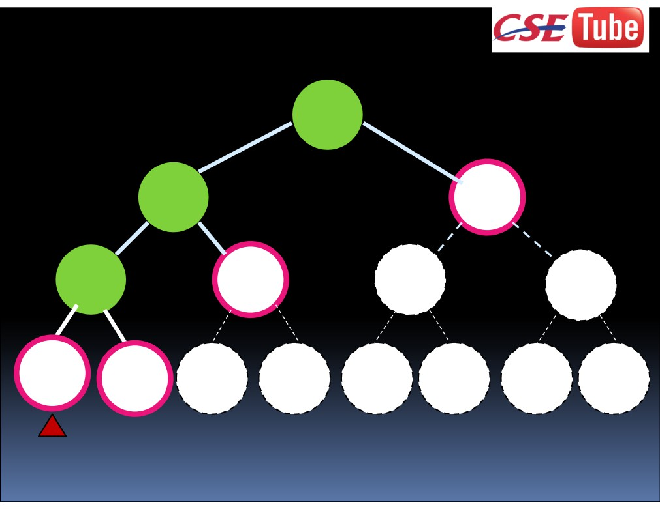
A
B
C
D
E F
G
H I J K L M N O

Slide 16
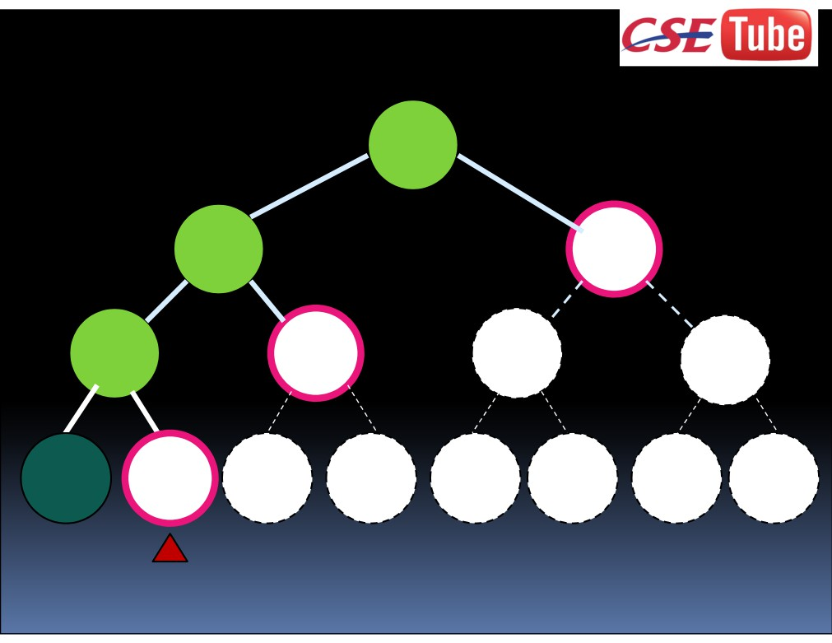
A
B
C
D
E F
G
H I J K L M N O

Slide 17
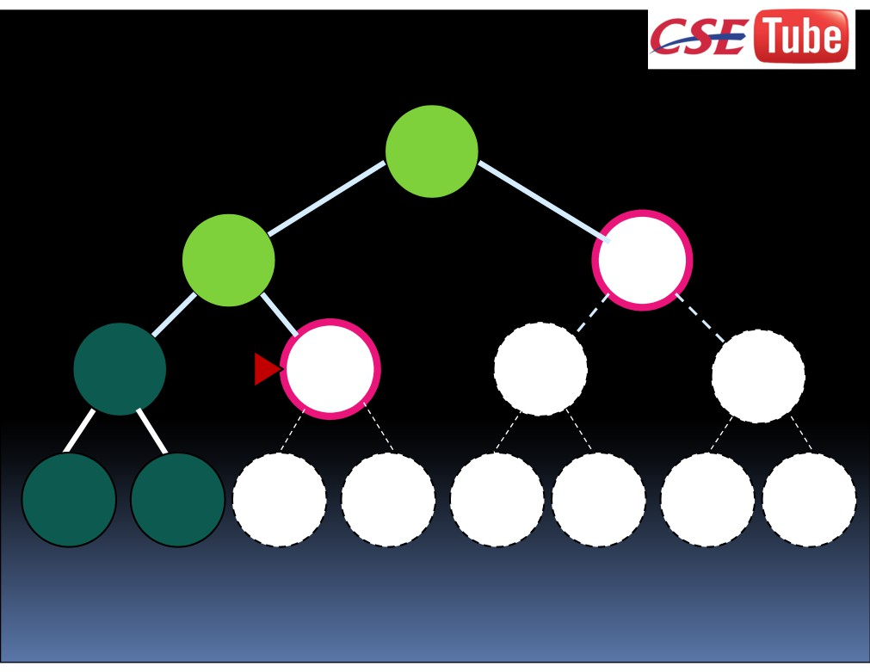
A
B
C
D
E F
G
H I J K L M N O

Slide 18
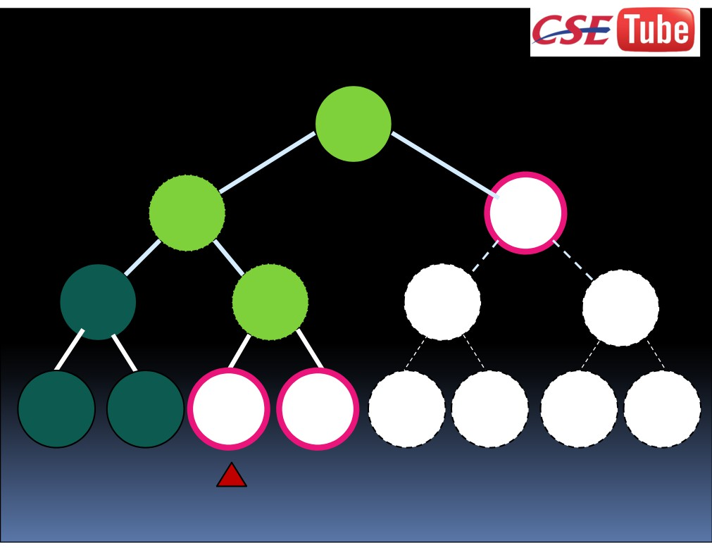
A
B
C
D
E F
G
H I J K L M N O

Slide 19
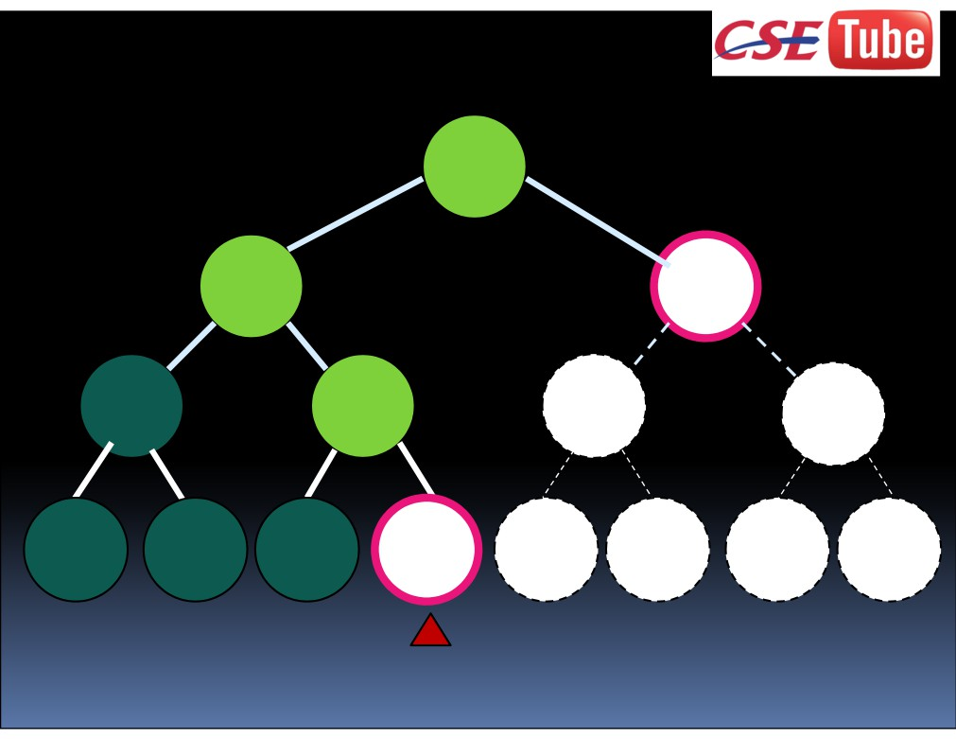
A
B
C
D
E F
G
H I J K L M N O

Slide 20
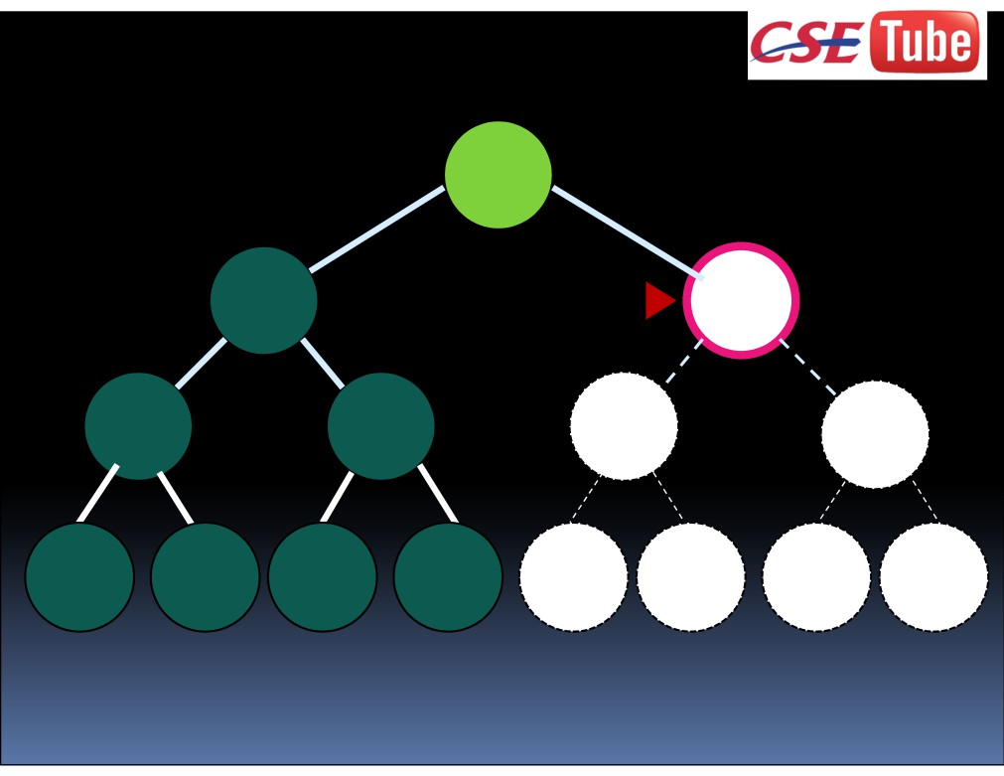
A
B
C
D
E F
G
H I J K L M N O

Slide 21
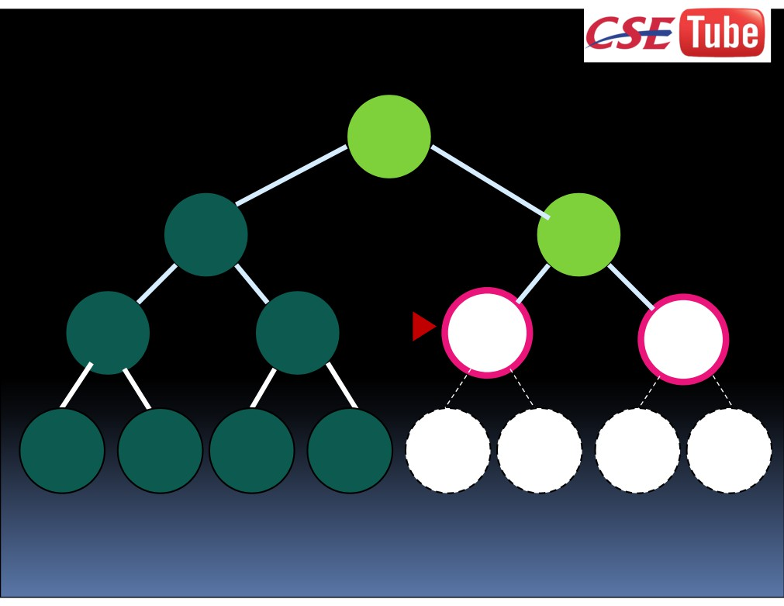
A
B
C
D
E F
G
H I J K L M N O

Slide 22
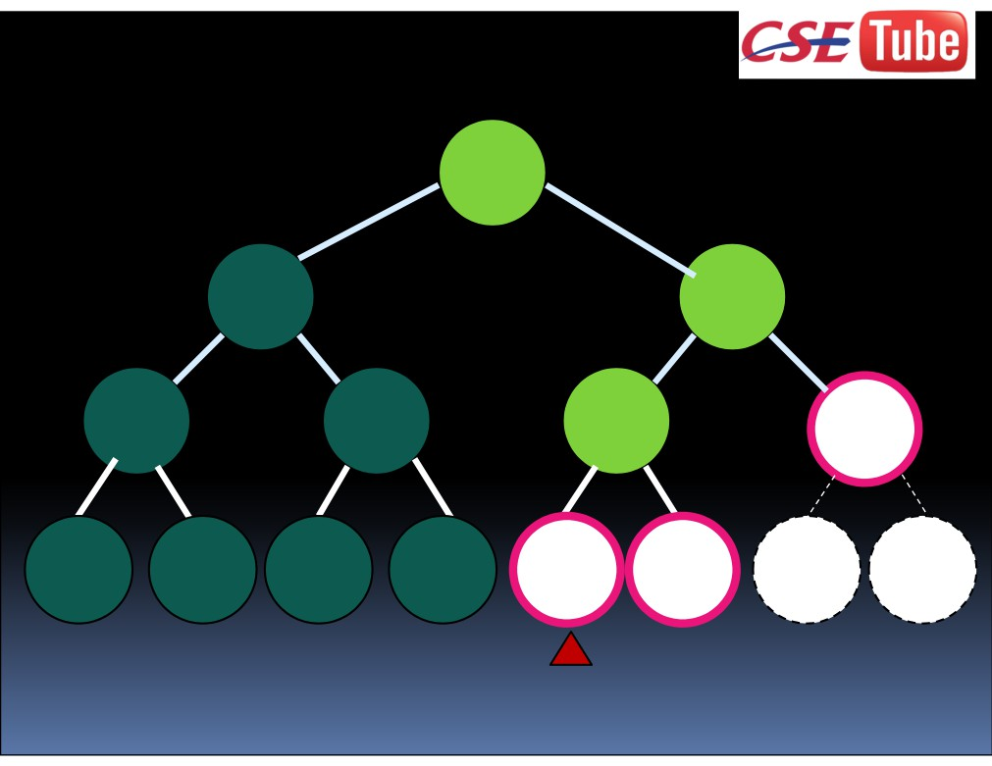
A
B
C
D
E F
G
H I J K L M N O

Slide 23
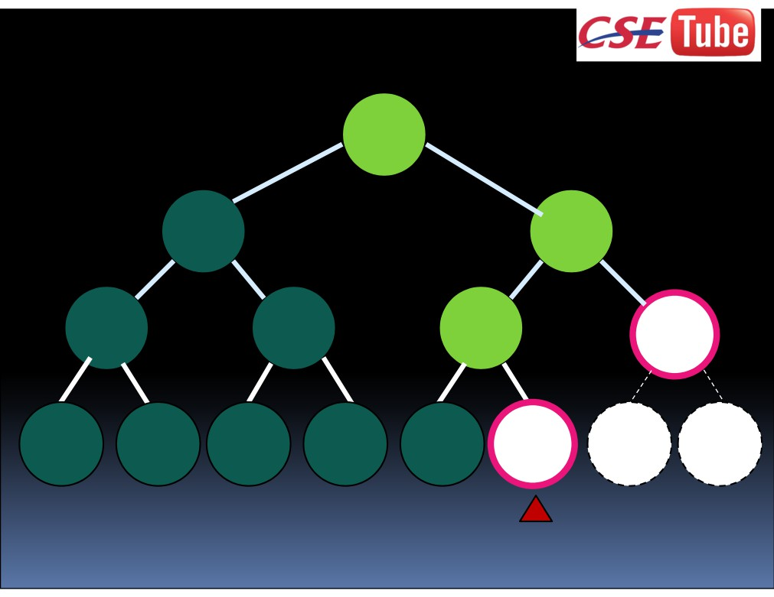
A
B
C
D
E F
G
H I J K L M N O

Slide 24
Properties of Depth-First Search:
Complete? No: fails in infinite-depth spaces, spaces with loops.
Modify to avoid repeated states along path => complete in infinite spaces
Time? O(bm): terrible if m is much larger than d but if solutions are dense, may be much faster than breadth-first.
Space? O(bm), i.e., linear space. Optimal? No

Slide 25
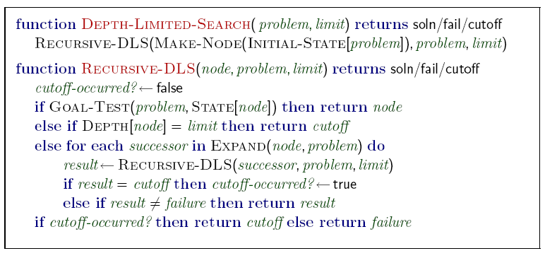
Depth-limited search
depth-first search with depth limit L
nodes at depth L have no successors
Notes:
The problem of unbounded trees in depth-first search can be solved by supplying a depth limit. (Depth-first trees can be seen as a special case where the limit is infinite).
Pseudo code for depth limited search shown – notice that “cutoff”=no result found within depth, while “failure”=all nodes searched, no goal found.
If L < D (solution depth) then it will be incomplete. Difficult to know D. If L > D, may be nonoptimal.
L can be set from knowledge of a domain. e.g. 20 cities therefore L=19, but by examining the graph, L = 9 steps. L is also known as the “diameter” of the state space.

Slide 26
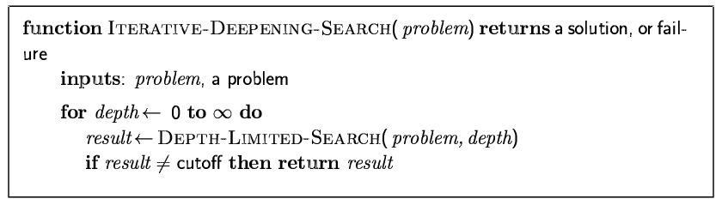
Iterative deepening
search to a depth limit L
if no solution research to limit L+1
previous search repeated
Notes:
Combines the best of depth-first and breadth-first search.
Gradually increase search limit until goal found.

Slide 27
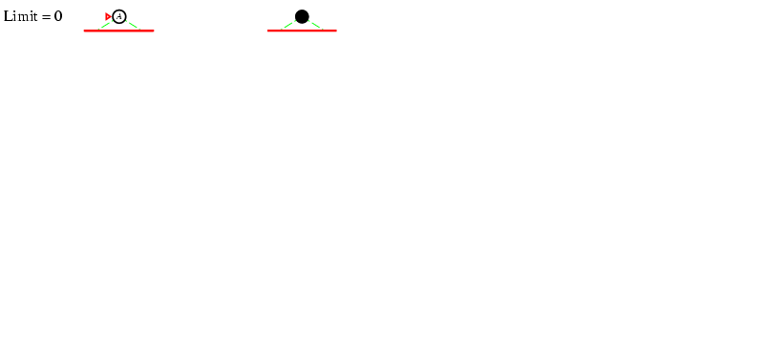
Iterative deepening search: L = 0
Notes:
Binary tree example.
Depth-first search with zero limit.

Slide 28
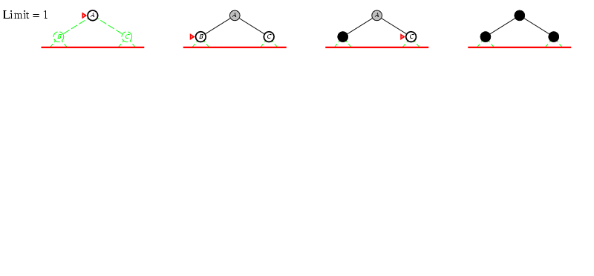
Iterative deepening search: L = 1
Notes:
Binary tree example.
Depth-first search with limit of 1.

Slide 29
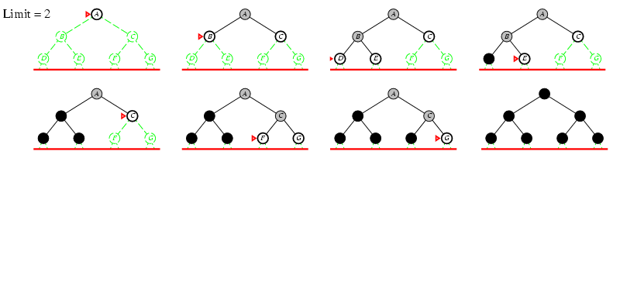
Iterative deepening search: L = 2

Slide 30
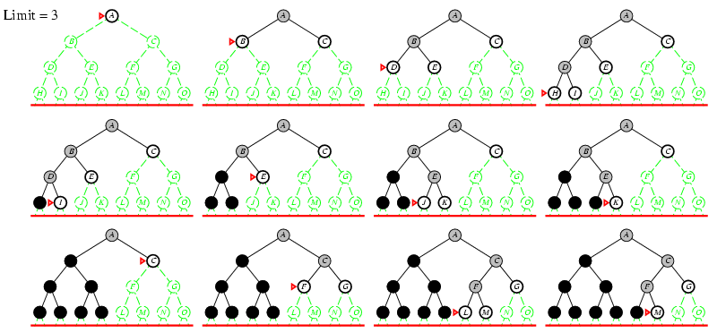
Iterative deepening search: L = 3

Slide 31
Iterative Deepening Search

Slide 32
Properties of iterative deepening
Complete?
Yes
Time:
(d+1)b⁰ + d b¹ + (d-1)b² + … + b^{d} = O(b^{d})
Space:
O(bd)
Optimal?
If the cost is the same per step
Notes:
b: maximum branching factor of the search tree
d: depth of the least-cost solution
m: maximum depth of the state space (may be ∞)
Complete: As long as the branching factor is finite.
Time: May seem wasteful as the states are generated multiple times, but as we’ve seen is O(b^{d})
Memory: Requirements like depth-first, a modest O(bd).
Optimal: When the path cost is non-decreasing function of the node depth.

Slide 33
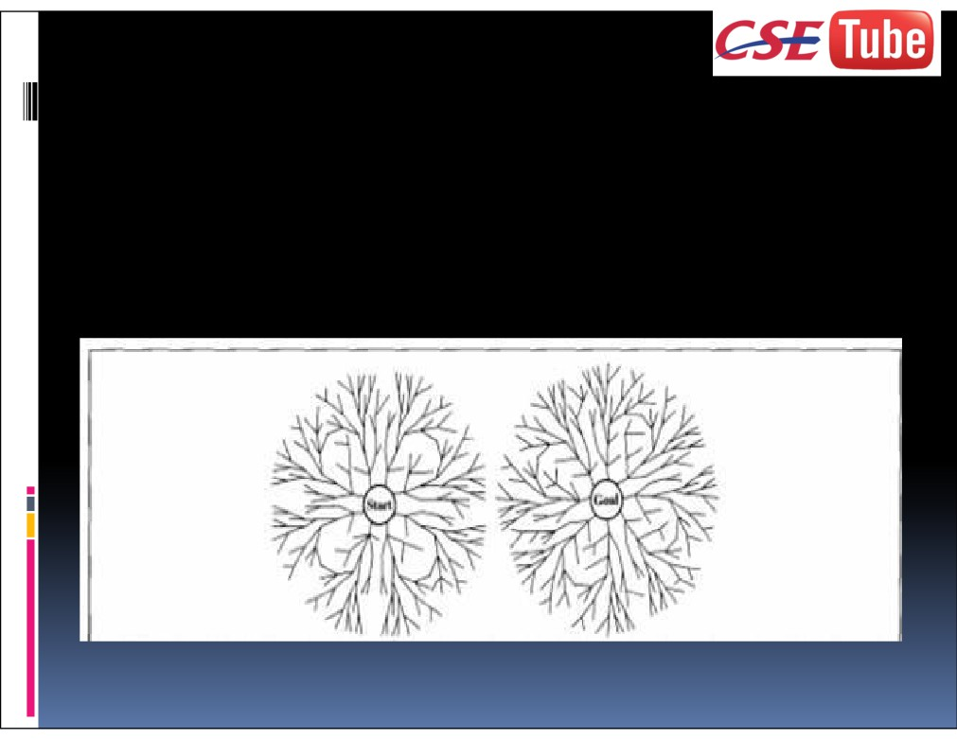
Bidirectional Search
Runs two simultaneous searches - one
forward from the initial state and the other backward from the goal.

Slide 34
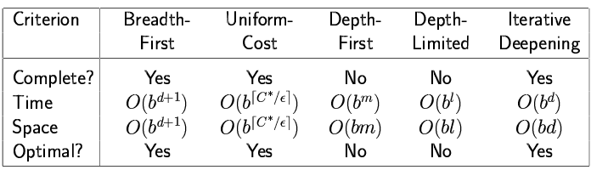
Summary of uninformed search
Notes:
time & space complexity measured in terms of:
b: maximum branching factor of the search tree
d: depth of the least-cost solution
m: maximum depth of the state space (may be ∞)
l: depth limit
C*: cost of optimal solution (Uniform cost search guided by path cost rather than depth, so no b or d)
ε: minimum action cost
(uniform cost worst case can be much larger because can explore large trees of small cost steps before any larger but potentially useful steps)
strategies evaluated according to:
completeness: always find a solution if one exists?
time complexity: number of nodes generated
space complexity: maximum nodes in memory
optimality: always finds a least-cost solution?

